Slide 1


Smart warehouse management
Deepak Saldanha
RN Vishwas
Ravindranath j
Project Management
Guided by Dr Parameshwar P Iyer (IISC)

Slide 2

The Big questions: Who?why?how? And everything else
Who? : Our consumer is e-commerce company Flipkart who need fast and quality maintained delivery of products to its online consumers
Why? : Growing competition in the area of e-commerce , many websites with varying products the feature which gives them an edge is quick and quality maintained delivery . total warehouse strength in India is Seventeen.
Flipkart has three fulfilment centers in Karnataka - one in Whitefield and two in Jigani. Flipkart will be opening the fulfillment center in Hyderabad size of 2.2 lakh sq ft and is expected to ship out 1.2 lakh items everyday.
Flipkart may spend $500 million to add 50-100 warehouses in next 5 years. Our project is 35000sqft in Mahipalpur (SW.Delhi). So One day Delivery is possible within 400kms radius. {Punjab-Lucknow,Up,Rajastan,Kashmir}

Slide 3

How current needs are met? : The current warehouse use human dependent management ,where it is prone to more errors and mismanagement of the warehouse rate leading delivery /mismatch of product in delivery
How is our solution better? : Our solution has minimal human interaction with minimal time taken to deliver a product as soon as the user orders in the e-commerce site. It takes us 44 weeks to complete our project.
How long will the solution work? :Our solution has the least human interaction with maximum output. The replacement of the human beings in delivery to drone will cause effect to our solution but our program can be altered to meet this demand and this replacement will take 10 years in future .

Slide 4
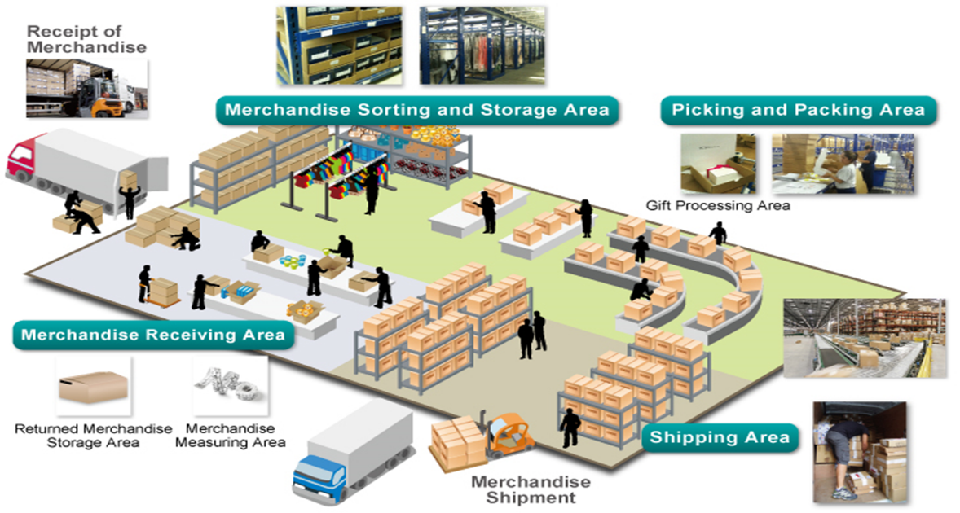

Slide 5
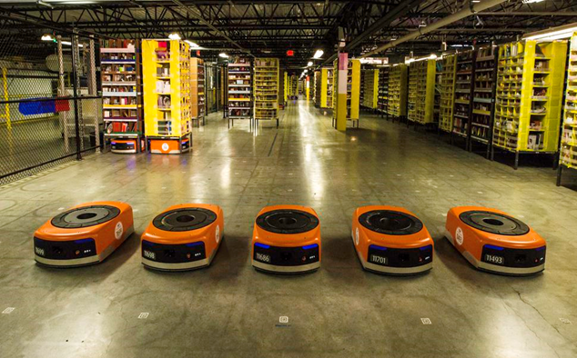
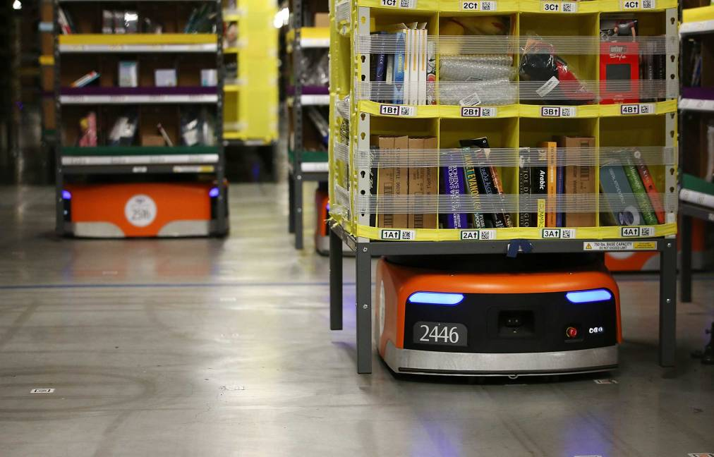
Sell me this pen!! How is our solution unique??
The USP of our solution to handle the warehouse is to have minimal human requirement to manage the warehouse and to increase the delivery rate . This gives an edge for the e-commerce website.
We use smart robots to handle the products
We have smart stacks to give all information about the products in it and they can move.
A conveyor belt process that can scan,print,label a product at the speed of 300 boxes/seconds.
Our solution can handle expansion of the warehouse as big as 750,000sq.ft. Our customer has a warehouse of 35000sq.ft
Which means we can handle a warehouse with minimal human effort of size upto 20acre.For our project a plain warehouse of 35000sq.ft is taken including the parking facilities and free movement of trucks

Slide 6
INPUT - ENVIRONMENTAL FACTORS - OUTPUT
Input – Location – Nearer to city limits , as one day delivery is possible for 400kms range location.
Land – An area of 35000sq.ft should be available
Constructed warehouse frame work
Automated Tools
Environmental Factors
Funding
Government Policy
Availability of Labor
Power and Water availability
Union Issue
Environmental Natural Disasters
Customs
Output – A warehouse which is lesser human interaction and delivery of products quicker and with quality maintained

Slide 7
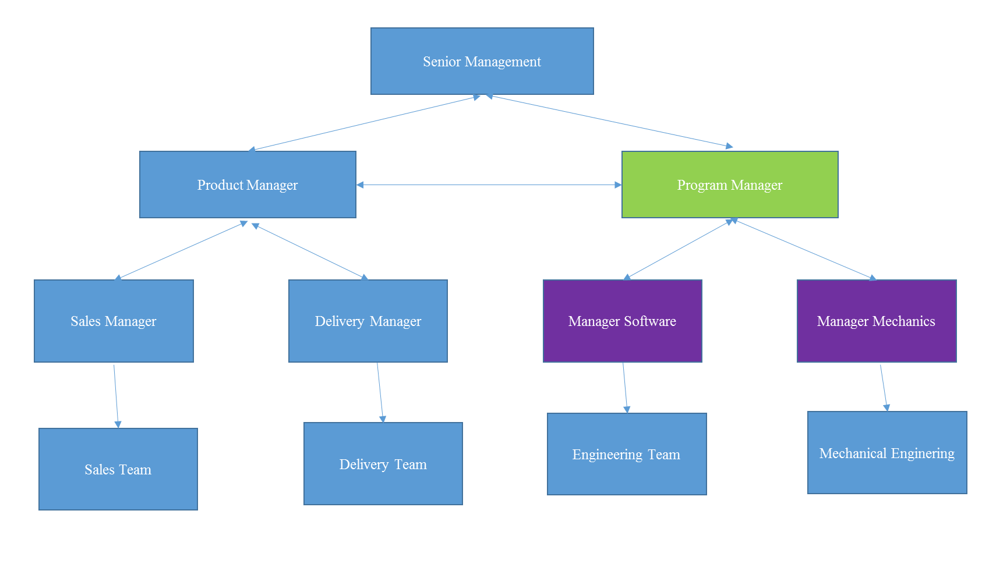
Attention Managers

Slide 8
What do we need to succeed ?
i-> Software Requirements
Ii-> Hardware Requirements
Iii-?Automated Mechanical Tools
These Include
• Automated storage and retrieval systems
• Automatic guided vehicles (AGVs)
• Automatic identification and data collection
• Casters and wheels • Controls
• Conveyors • Dock equipment
• Ergonomics • Hoisting equipment
• Industrial robots • Integrated material handling systems
• Item order fulfillment systems • Lift trucks
• Monorails and workstation cranes • Overhead cranes
• Packaging • Protective guarding
• Racks • Software
• Sortation

Slide 9
Work Breakdown Structure
Smart Warehouse Management
Feasibility
Detailed Engineering Design
Procurement
Installation
Design
Transportation Necessity
Power Supply
Water Supply
Government Regulations
Human Resource availability
High Level Design
Rough Costing
Sign Off
Machine Design Development
Man power Estimation
Software Development
Order Placement
Payments
Shipping
Customs
Man Power Recruitment
Clearance
Delivery to site
Installation
Handover
Testing
Trail Runs
Handover

Slide 10
Framework
Smart Warehouse Management
Receiving
Picking
SLAM-ing
Packing
Shipping
Delivery
Package status updated to consumer and datbase
Receive goods from dealer
Checking of packages
Update warehouse database
Pellet formation
Stacking of pellets with UIC
Smart Stcaks Update with goods and database update
Order received from consumer
New Order details stored in Data base
Smart Stacks Movement for packing
Packing of goods by human
Packet details updated to data base
Parcel moved to coveyor belts
Bar Code generated and applied to parcel
Scanning of parcel
Label generation with address
Applying label
Manifest
Update database
Label Check
Division based on Pin codes
Final check
Loading to Trucks
Update database
Delivery of parcel
Update details of delivery

Slide 11
WBS CODE | ROLE Project Deliverable | Project Owner | Client Representatives | Project Manager | Finance Team | Complete Testing | Software Testing | Software Development | Software Design | Mechanical Tools Testing | Mechanical Tools design and Development
01AM3 | Goods Arrival Database |  | I | I | I |  | A | R | A
01AM5 | Pellet Stacking with UIC and mechanical arm |  | I | I | I |  | A | R | A | A | R
01AM6 | Smart Stacks |  | I | I | I |  | A | R | A | A | R
01BM1 | E-Commerce site order details management |  | I | I | I |  | A | R | A
01BM2 | Smart Stacks Movement |  | I | I | I |  | A | R | A
01CM2 | Packing data base |  | I | I | I |  | A | R | A
01D | SLAM Process |  | I | I | I |  | A | R | A | A | R
01E02 | Shipping data base |  |  |  |  |  | A | R | A
01E03 | Delivery data base |  |  |  |  |  | A | R | A
 | Complete system check and delivery | I | A | A | A | R

Slide 12
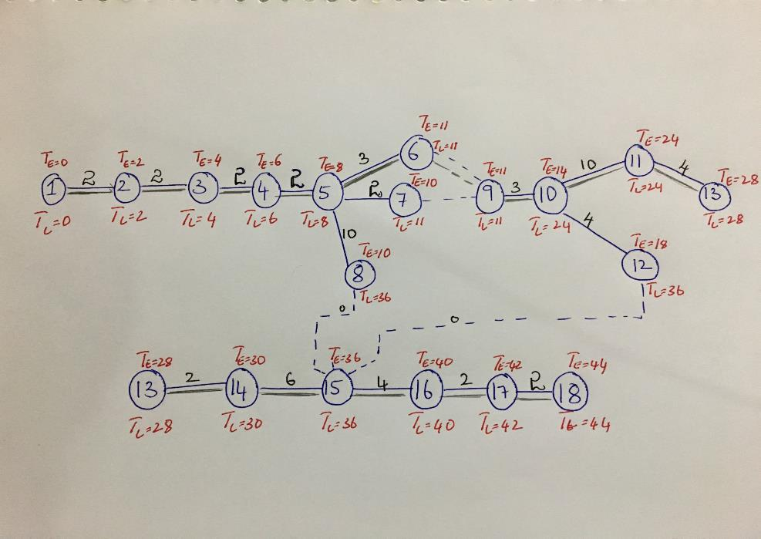

Slide 14
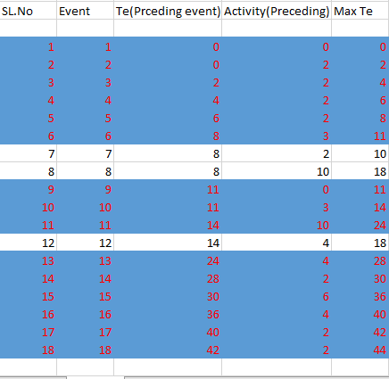
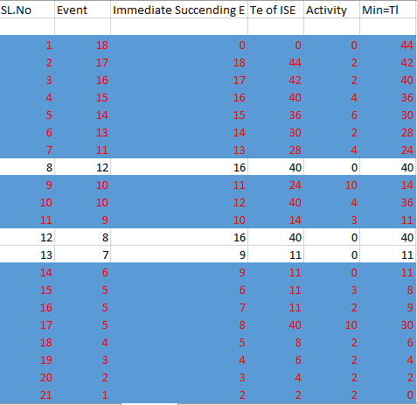
Lead and Lag analysis

Slide 15
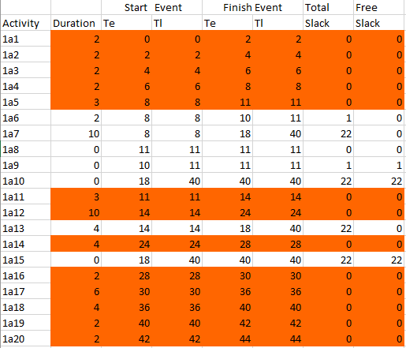
Total Slack and Free Slack

Slide 16
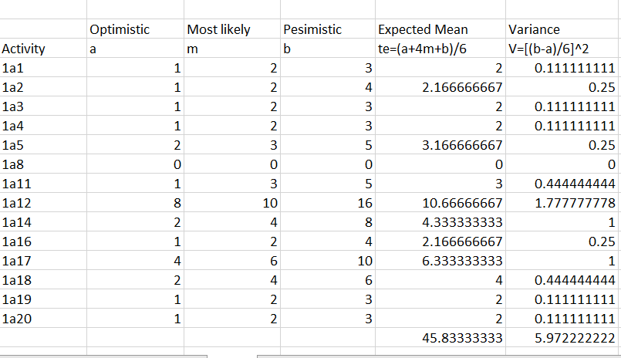
Three Time Estimate

Slide 17
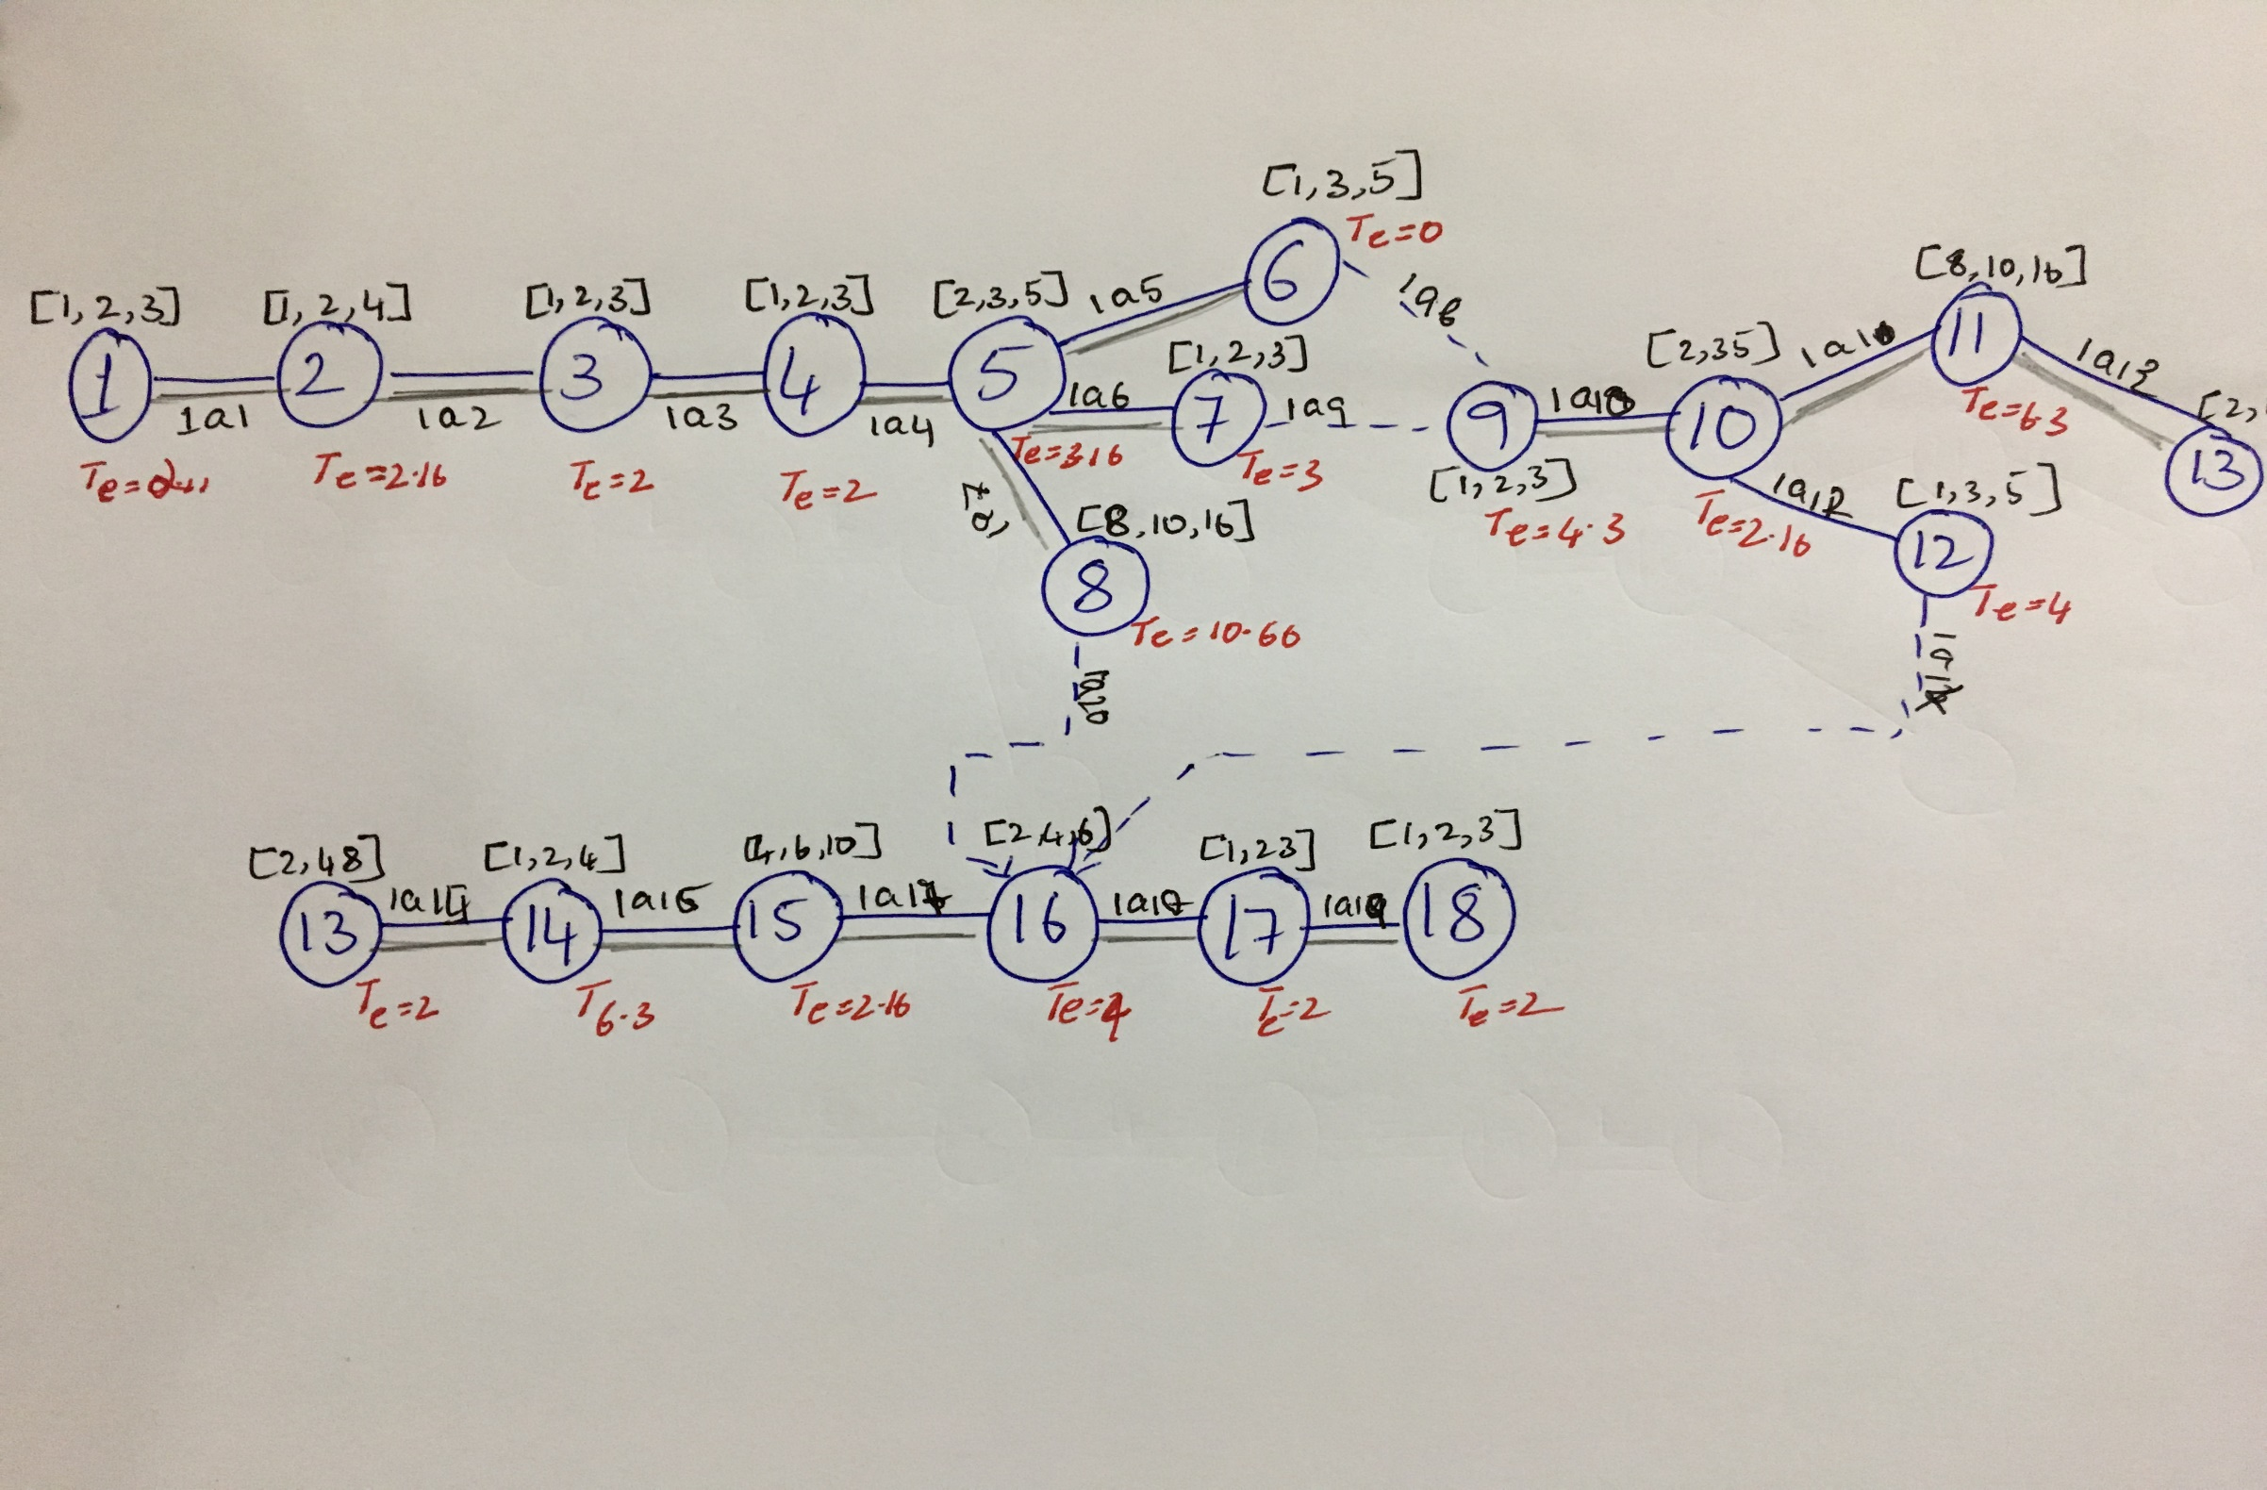

Slide 18

Probability of Completion
Probability of Project Completion is given by (44-45.833)/sq.rt(5.972) .
From which we have deduced that completing the project in 44weeks has a 77% probability
To achieve 99% Probability Ts=Te+Z+Vp
Te=45.83
Z=2.8
Vp=5.97
Ts=54.6 weeks
Which tells us that to achieve a probability of 99.2% it takes 54.6 weeks for completion

Slide 19
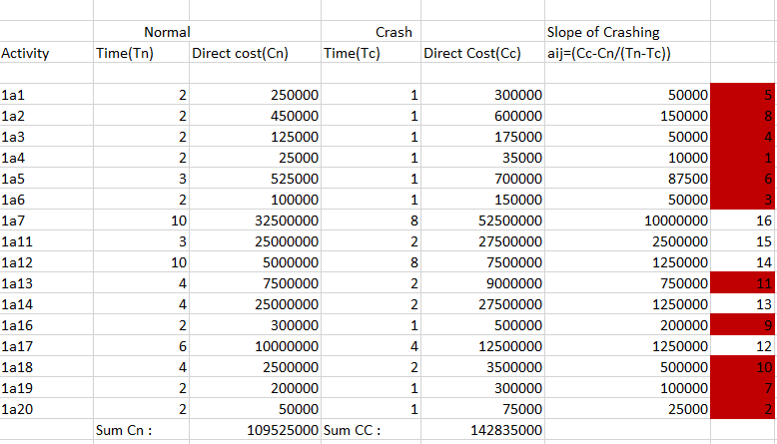
Crashing

Slide 20
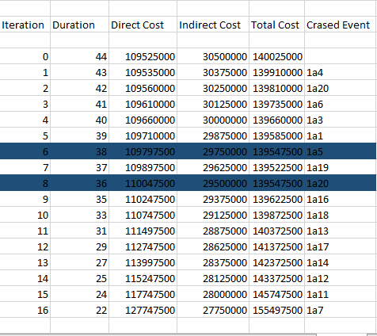
Finding the Feasible Path

Slide 21
What did we learn??
Union Strikes – At the initial stage of the project faced union strikes as the project cuts down workers. Automation of any existing project faces union problems
Demonetization – Sudden changes in Government policy leads to halt of work . Payment to daily wages workers is difficult and leads to huge delays in project.
Funding issue also occurs as COD revenue is more over 75% the company’s revenue generator.
Foreign Competitors – Amazon which a company which is well established and estimated to be over 70billion is investing over 4billion into Indian market to Flipkart’s 500million.

Slide 22




